Slide 1
Statistics in Sports: (American) Football Overview
Zachary Binney, PhD MPH
Oxford college of emory university
Fall 2023

Slide 2
Roadmap
1. Football is Complex and Chaotic
2. Predicting Probabilities of Events
Field Goal Model
Expected Points Added (EPA)
Win Probability Added (WPA)
3. Fourth Down Decisions
4. Draft Analytics
5. NFL Player Valuation Analytics
Overview of Passing Stats
Box Score Stats, ANY/A
Passer Rating, (Total) QBR
Air Yards/aDOT vs. YAC
EPA/WPA and Translation to WAR
6. Tracking/Next Gen Stats (NGS) Data
Play Expectations
Player Valuation vs. Expectation
Big Data Bowl
7. Lineman Analytics: Pass Blocking and Rushing
Survival Analysis

Slide 3
Intro

Slide 4
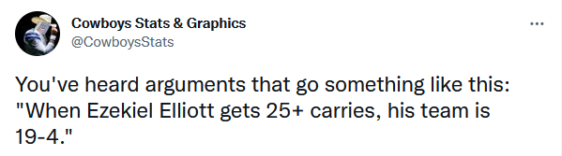
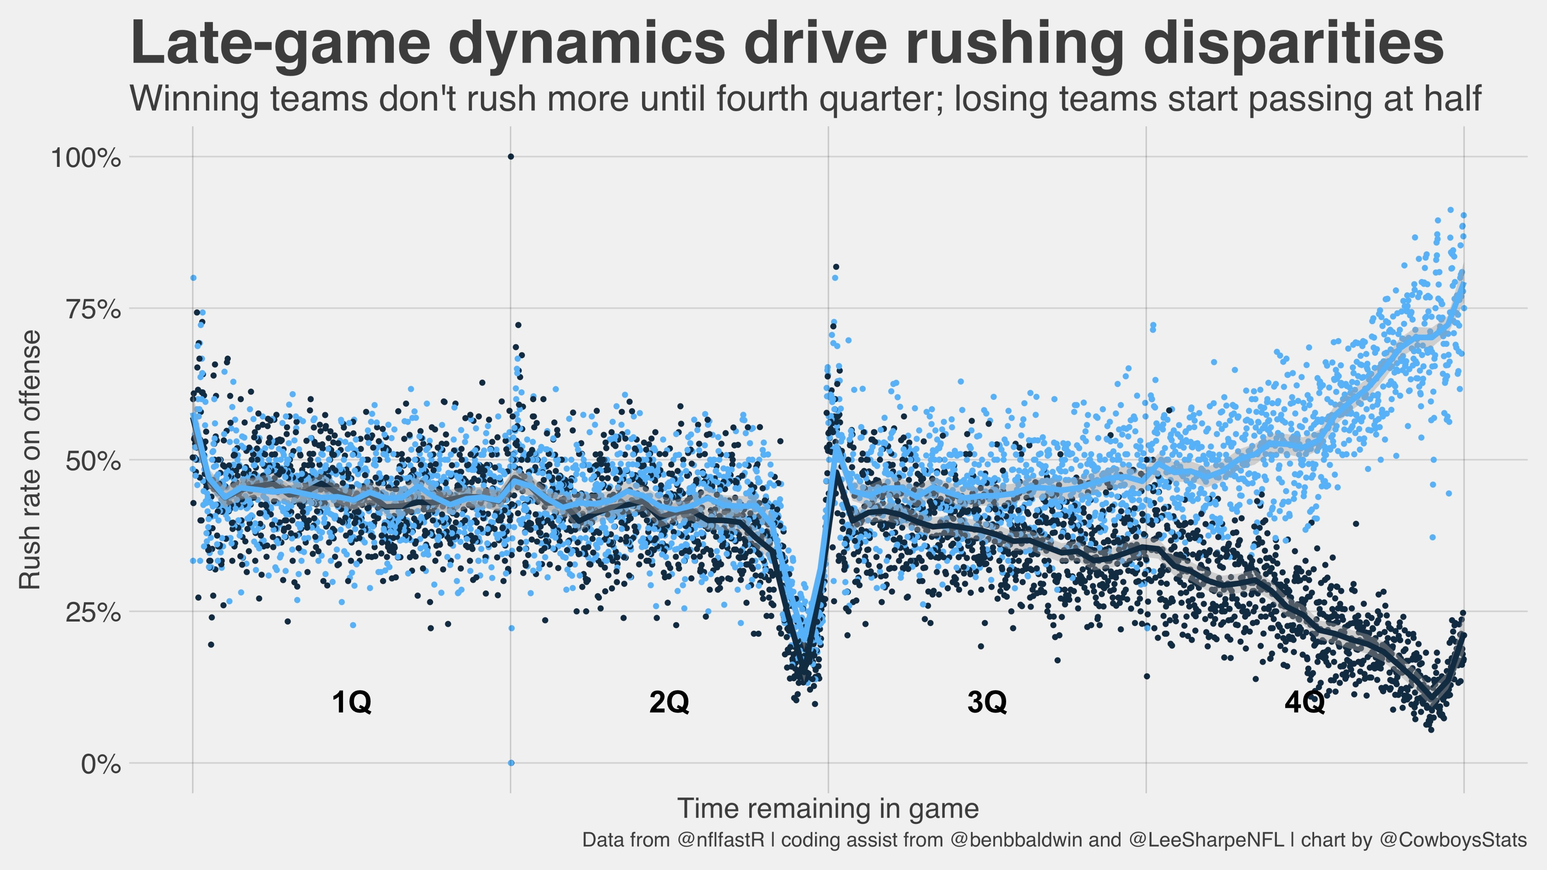
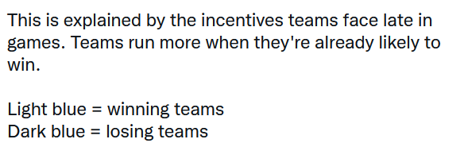
“Teams That Run Win More”
We start with a puzzle: why are these bullshit?
Source: https://twitter.com/CowboysStats/status/1374112221895266304?s=20

Slide 5
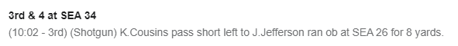
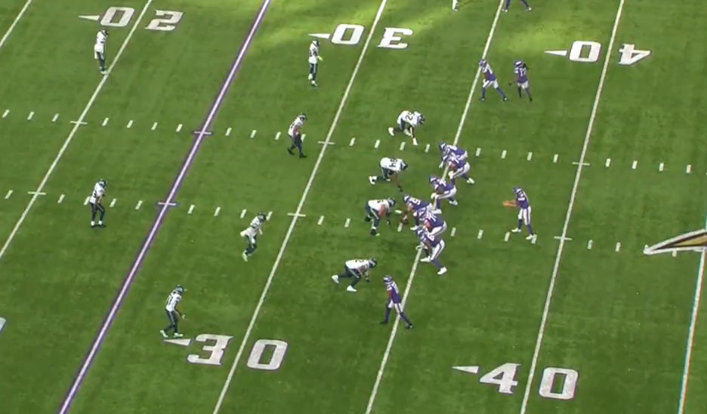
Football is Complex and Chaotic
Let’s break down a play: Seahawks @ Vikings, 9/26/21
MIN 21-SEA 17;
Source: https://twitter.com/benbbaldwin/status/1442928810010169347; https://www.espn.com/nfl/playbyplay/_/gameId/401326376

Slide 6
Data Contained in a Football Play
Let’s break down a play: Seahawks @ Vikings, 9/26/21
MIN 21-SEA 17
How could we break down this film and/or play-by-play text into analytical “nuggets” for a computer? In other words, how can we “encode” something like this for analysis?
“Tokenization” (text analysis, not data security)
Source: https://www.espn.com/nfl/playbyplay/_/gameId/401326376

Slide 7
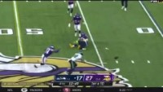
Data Contained in a Football Play
Let’s break down a play: Seahawks @ Vikings, 9/26/21
OK, got that? Easy, right? Now do this from the same game:
MIN 27-SEA 17
Source: https://www.espn.com/nfl/playbyplay/_/gameId/401326376

Slide 8
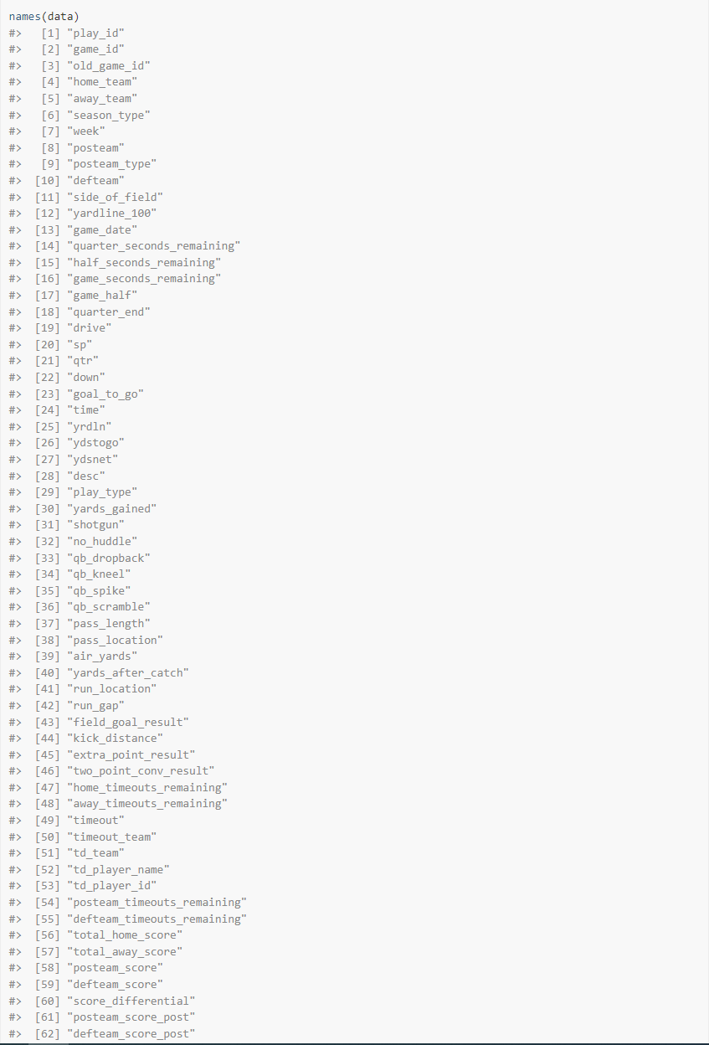
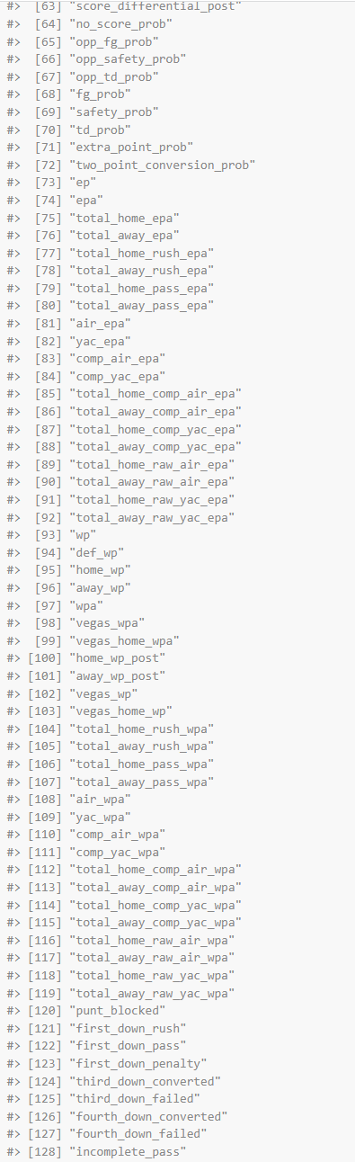
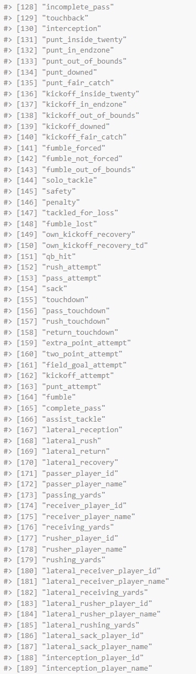
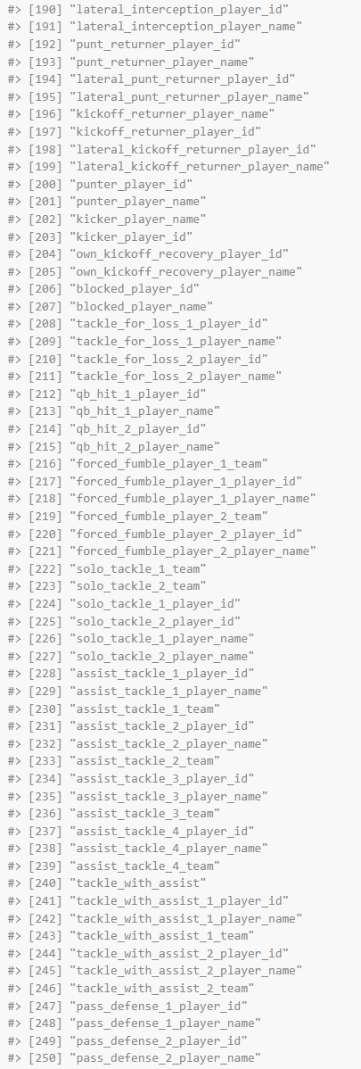
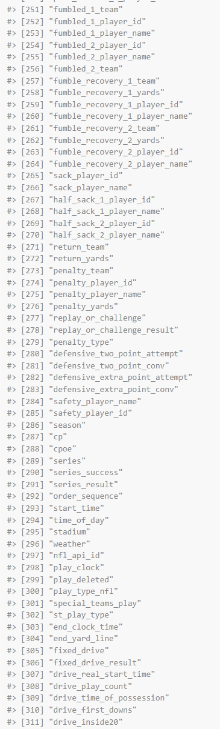
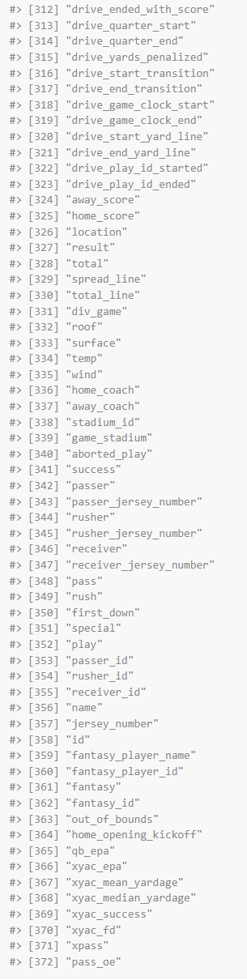
Data Contained in a Football Play
Possible fields for one play from nflfastR play-by-play analysis
Source: nflfastR

Slide 9
Data Contained in a Football Play
Data for one play in nflfastR
…
…
Source: nflfastR

Slide 10
Predicting Probabilities of Events
Field Goals
Expected points
Win probability

Slide 11
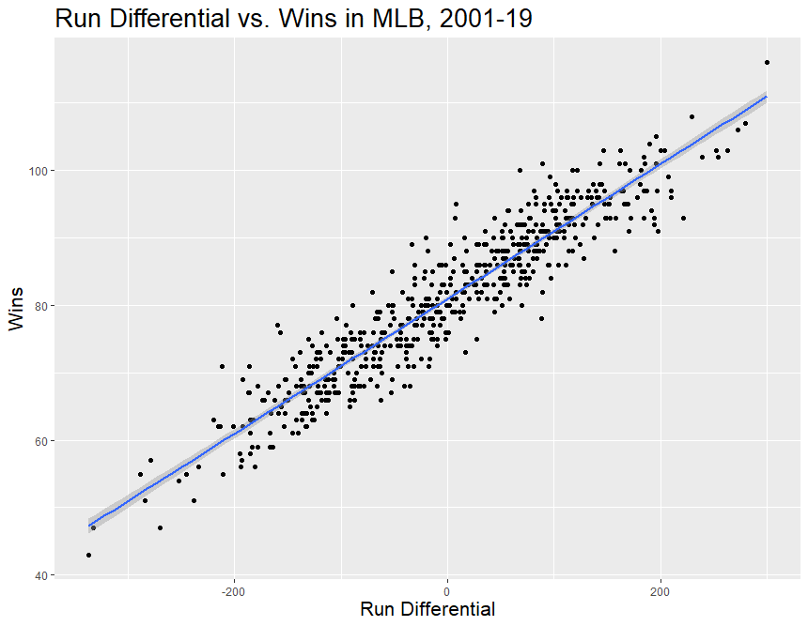
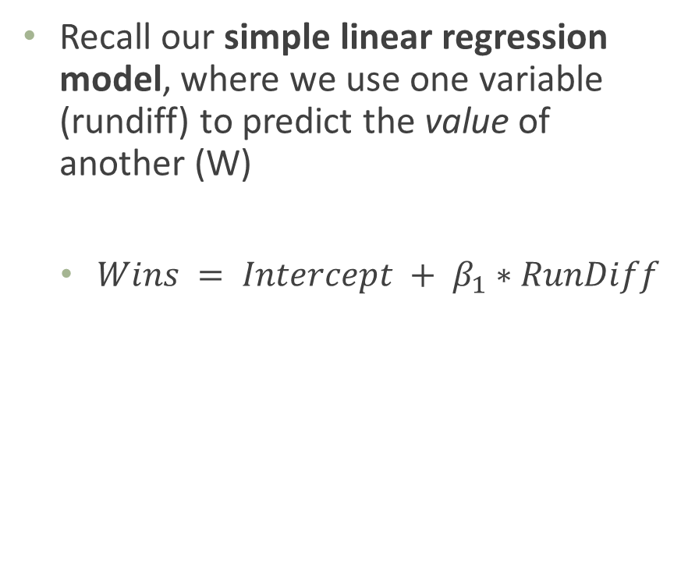
Simple Linear Regression
Recall our simple linear regression model, where we use one variable (rundiff) to predict the value of another (W)
$Wins = Intercept + β_{1}∗RunDiff$
Source: Lahman

Slide 12
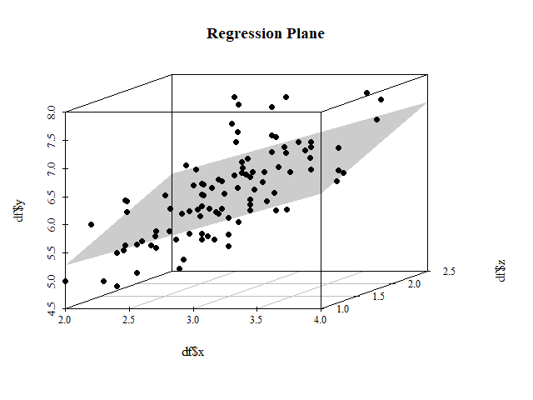
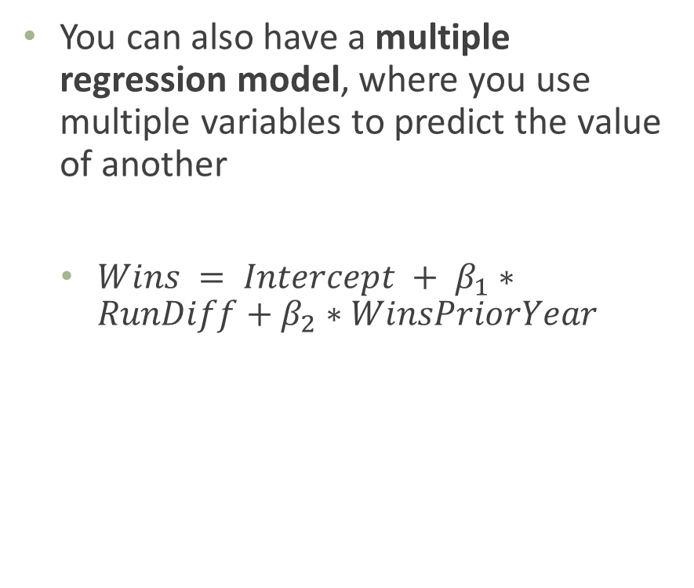
Multiple Linear Regression
You can also have a multiple regression model, where you use multiple variables to predict the value of another
$Wins = Intercept + β_{1}∗RunDiff+β_{2}∗WinsPriorYear$
Source: https://stackoverflow.com/questions/47344850/scatterplot3d-regression-plane-with-residuals

Slide 13
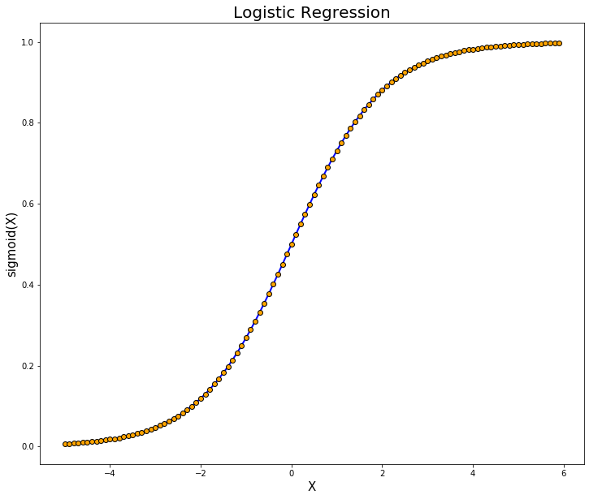
Predicting Categorical Variables
How do we predict the “value” of a categorical (let’s say binary) variable?
One method: predict its probability
Could we use linear regression for this?
To keep limited to {0,1} we’ll predict probability using a slightly different technique called logistic regression
Skipping underlying math
Source: https://towardsdatascience.com/logistic-regression-explained-9ee73cede081

Slide 14
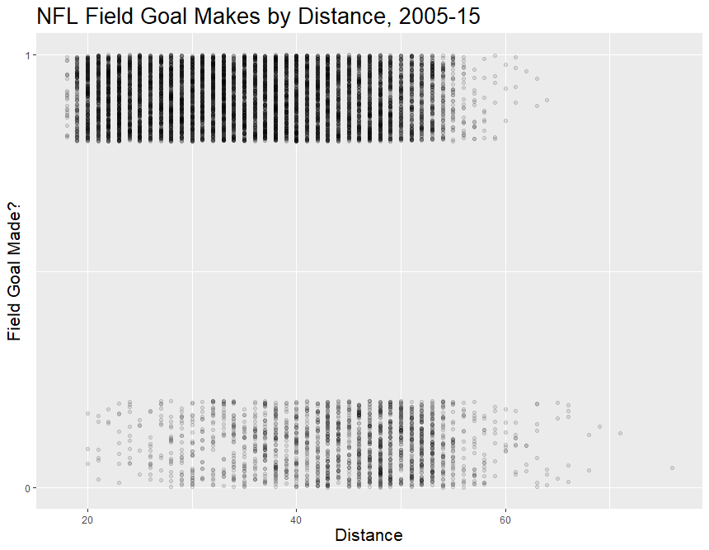
Predicting Field Goal Probability
RAW DATA
Source: https://raw.githubusercontent.com/statsbylopez/StatsSports/master/Data/nfl_fg.csv

Slide 15
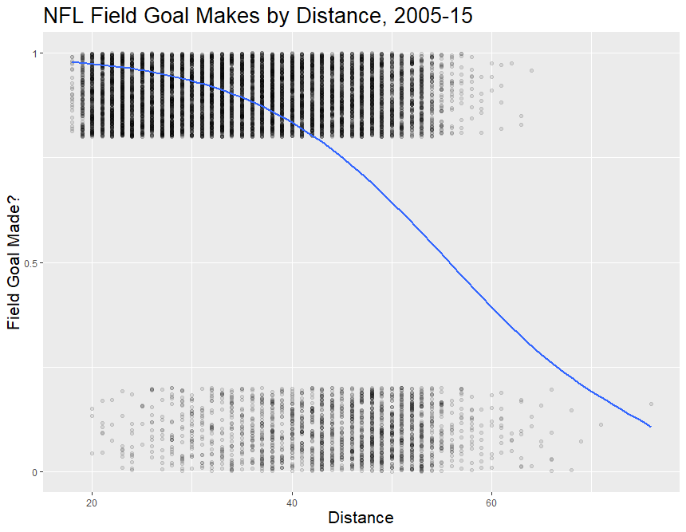
Predicting Field Goal Probability
RAW DATA + LOGISTIC REGRESSION MODEL PREDICTIONS
Get Pr(Field Goal Made = 1 | Distance = X)
What is the approximate probability of nailing a 40-yd field goal? Pr(Field Goal Made = 1 | Distance = 40) = ???
Source: https://raw.githubusercontent.com/statsbylopez/StatsSports/master/Data/nfl_fg.csv

Slide 16
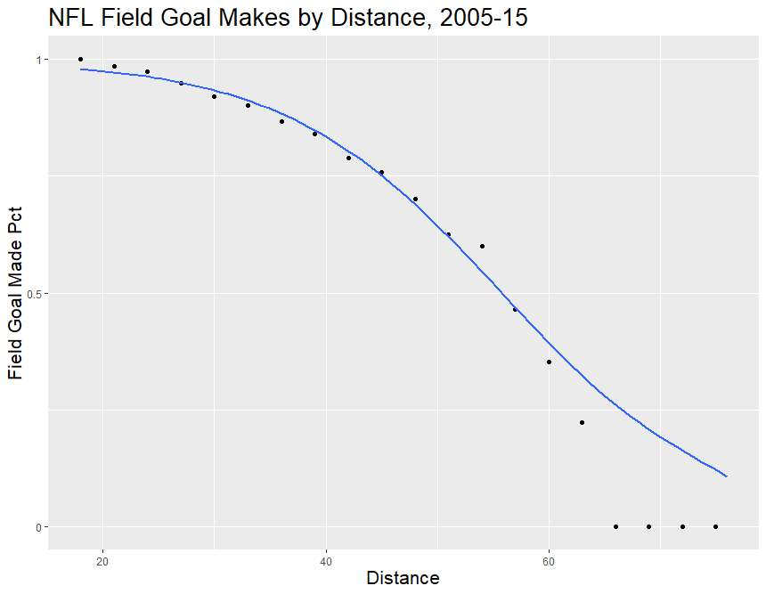
Predicting Field Goal Probability
BINNED RAW DATA + LOGISTIC REGRESSION MODEL PREDICTIONS
Note we DON’T bin the data to run the model – this is just for a plot that makes more sense
Just like linear regression, could add more variables (e.g. year, grass vs. artificial turf) to our model to improve accuracy. But we won’t bother here.
Source: https://raw.githubusercontent.com/statsbylopez/StatsSports/master/Data/nfl_fg.csv

Slide 17

Expected Points
Now that we know how to predict the probability of a binary event like a field goal, let’s do something more useful
What’s the point of a football team? How do you win?

Slide 18
Expected Points
Predict value of current game state for offense by calculating expected value of next points scored
From offense’s perspective, next score could be: +8, +7, +6, +3, +2, 0, -2, -3, -6, -7, -8
Simplify to +7, +3, +2, 0, -2, -3, -7
Expected Points = Pr(Next Score +7)*7 + Pr(Next Score +3)*3 + … + Pr(Next Score -7)*-7
Where do the probabilities come from?

Slide 19
Expected Points
Fairly simple logistic regression* model based on
Down
Distance to go for first down
Field position (yard line or distance from opponent end zone)
Time left (some models)
Intuition: how would each of these impact expected points for the offense?
* Note model is more complex because predicting probability of several mutually-exclusive events, but not fundamentally different from field goals.

Slide 20
Expected Points
Calculation example: Vikings, 3rd & 4 from SEA 34, 10:66 left in 3rd quarter
What are the expected points for the Vikings?
Event Value | Probability
+7 | 0.40
+3 | 0.40
+2 | <0.01 (treat as negligible)
0 | 0.08
-2 | 0.02
-3 | 0.10
-7 | 0.10

Slide 21
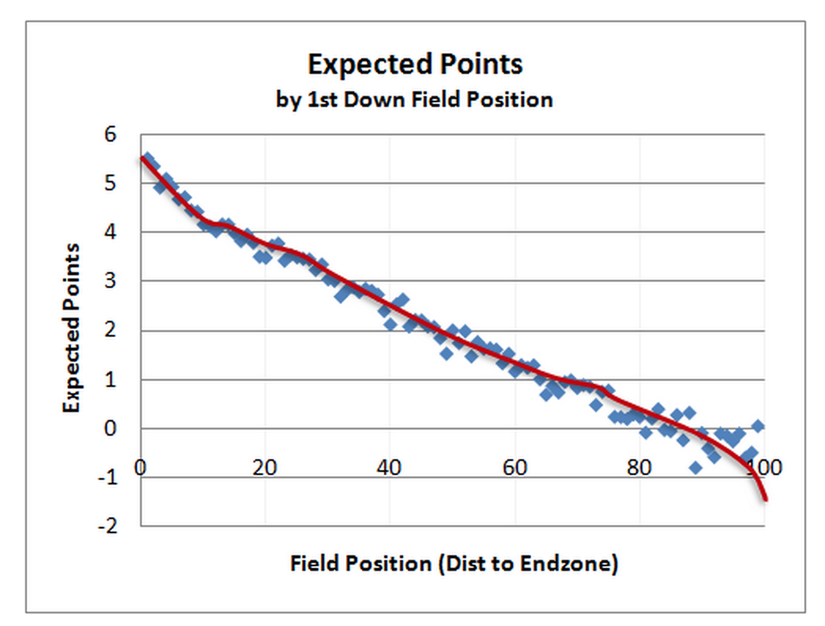
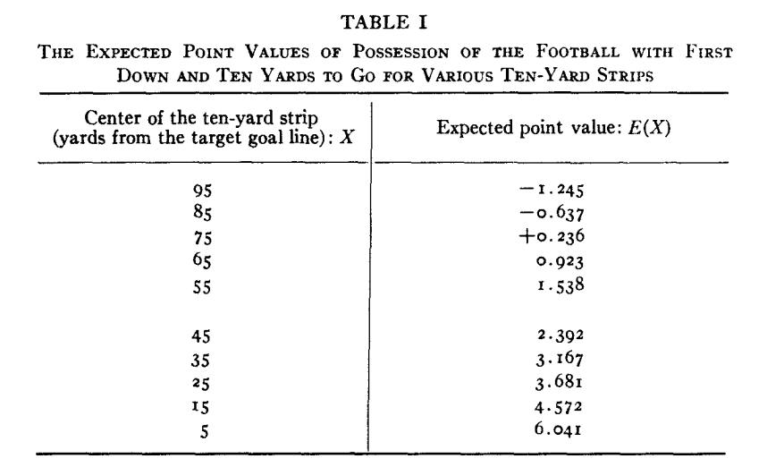
Expected Points
Various expected points models
Source: Carter and Machol, 1971; Burke 2010 http://www.advancedfootballanalytics.com/2010/01/expected-points-ep-and-expected-points.html

Slide 22
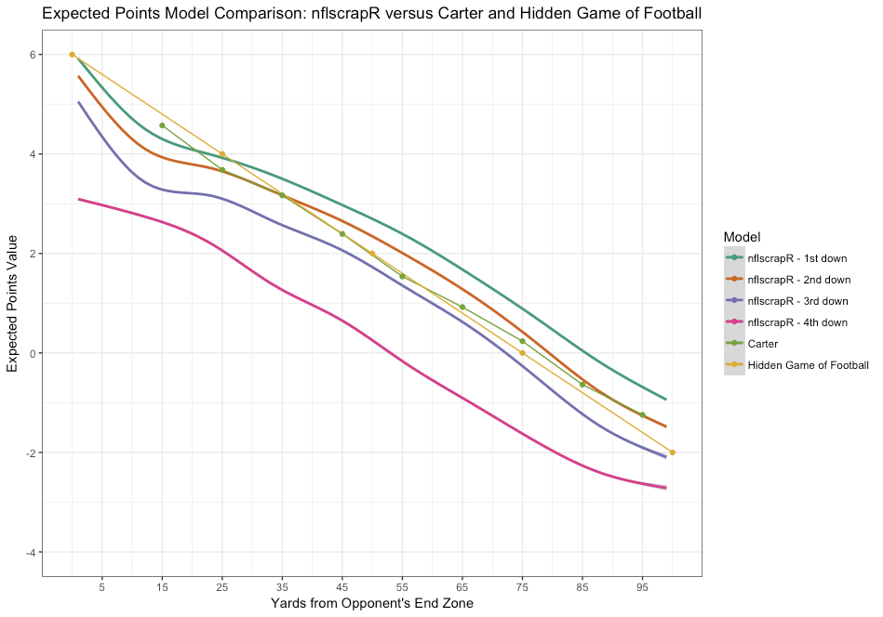
Expected Points
Various expected points models
Source: Yurko et al 2019, https://www.degruyter.com/document/doi/10.1515/jqas-2018-0010/html

Slide 23
Expected Points Added
Expected points are nice in their own right, I guess
But real value comes from being able to compare two game states – like before and after a play
Expected Points Added (EPA)
Source:

Slide 24
Expected Points Added
What do you think EPA would say about each of these plays?
A completed 3-yard pass on 1st & 10?
A completed 3-yard pass on 3rd & 2?
Source:

Slide 25
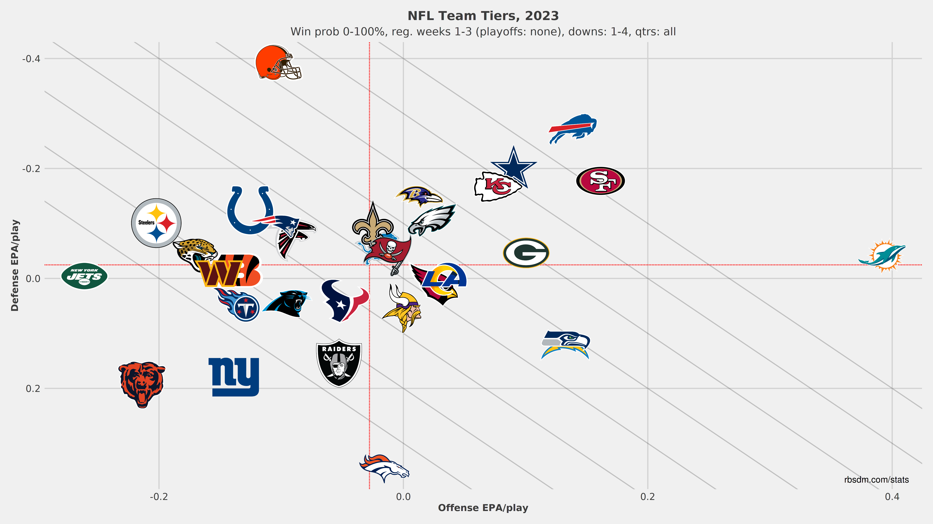
Expected Points Added
EPA can be used to value:
Plays
Coach decisions (go for it vs. kick on 4th down)
Team offensive and defensive units (by summing up EPA of all their plays)
(With a lot more work to divide credit) individual player value
Source: https://rbsdm.com/stats/stats/

Slide 26
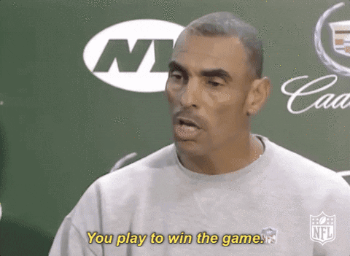
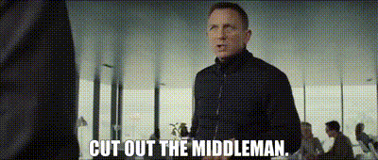
Win Probability
But it’s not really about points, is it?
Fair enough, coach, so what should we-
Source: https://getyarn.io/yarn-clip/98c1c9aa-613e-4a69-a280-8b57407be664/gif; https://statsbylopez.netlify.app/post/r-for-nfl-analysis/; https://arizonastate.rivals.com/news/you-play-to-win-the-game-an-oral-history-of-a-memorable-moment

Slide 27
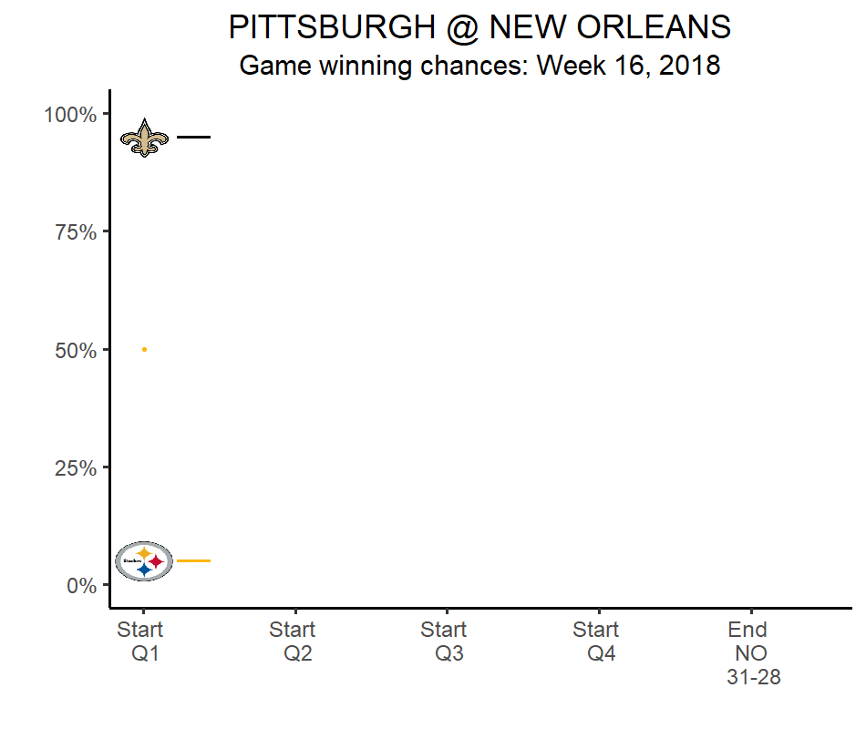
Win Probability (Added)
We could just model the probability of winning directly
Win Probability models
Just like going from expected points → EPA, we can calculate win probability added (WPA) for any play
Use EPA or WPA? Case-by-case
Source: https://statsbylopez.netlify.app/post/r-for-nfl-analysis/

Slide 28
Fourth Down Analyses

Slide 29
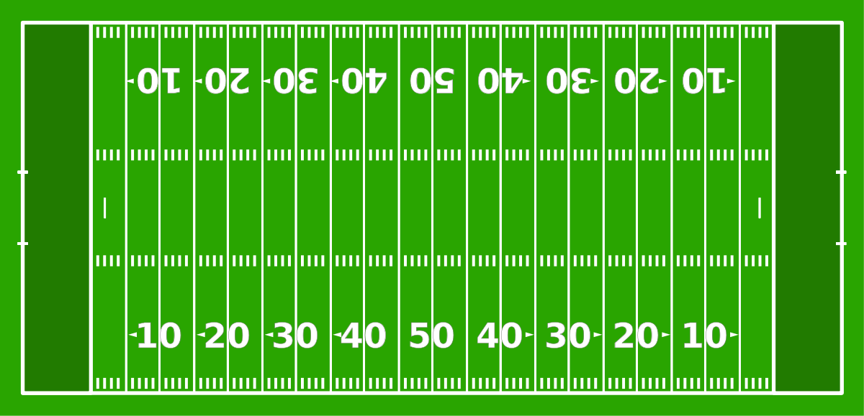
Fourth-Down Decisionmaking
4th Down
Punt to Other Team
Kick Field Goal (3 pts, if in range)
Go for it
Opponent gets ball further from goal line
Miss: opp. gets ball closer to goal line
Make: +3 pts
Success: drive continues
Fail: opp. gets ball at spot of failure
Opp. End Zone
Source: https://en.wikipedia.org/wiki/American_football_field

Slide 30
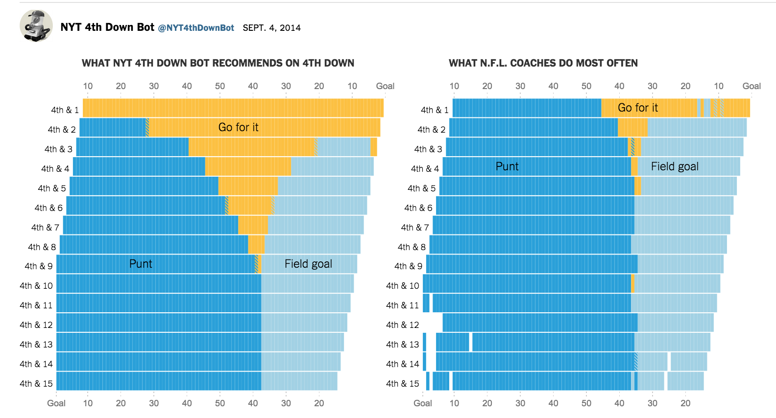
Fourth-Down Decisionmaking
What should a coach do? Recommendations (as of 2014):
Source:

Slide 31
Fourth-Down Decisionmaking
Where do these recommendations come from?
You’ll be shocked to hear, but… EPA or WPA!
Need:
1. Pr(success) of your choice
100% for punt, high for field goal (if in range), maybe lower for go-for-it
2. Weighted EP or WP for each choice:
Example: say you’re at 4th & 1 at opponents’ 23 yd line and have an 80% chance of success (converting it).
Then EP(Go for it) = 0.8*EP(Go for it and succeed) + 0.2*EP(Go for it and fail)
Compare to EP(FG) = 0.9*3 + 0.1*EP(FG Miss)
Then (in many but not all cases) choose highest EP or WP option
Time when you shouldn’t do this?
Source:

Slide 32
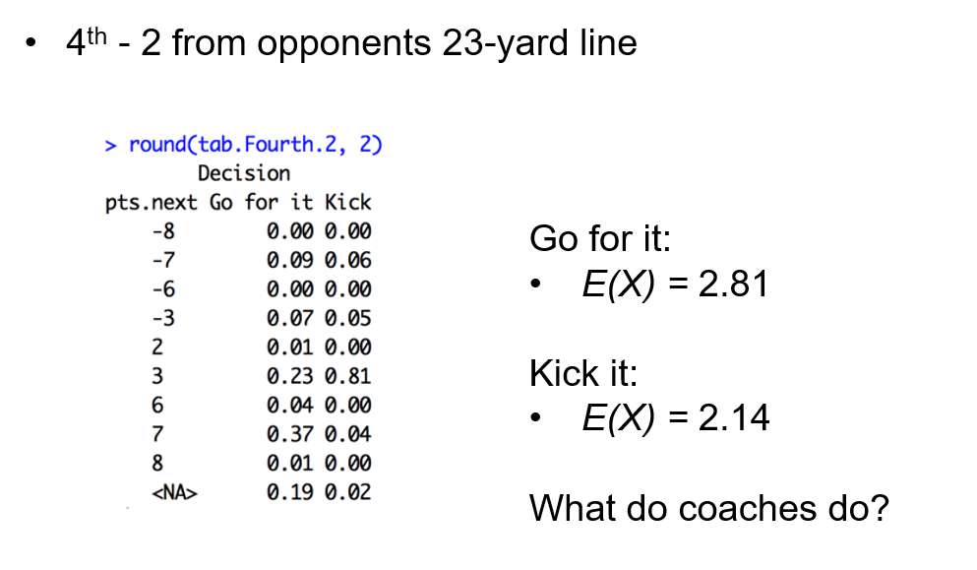
Fourth-Down Decisionmaking
Example:
Source: https://github.com/statsbylopez/StatsSports20/blob/master/Lectures/lecture%206.pdf

Slide 33
Fourth-Down Decisionmaking
What did coaches actually do (as of 2014)?
Source:

Slide 34
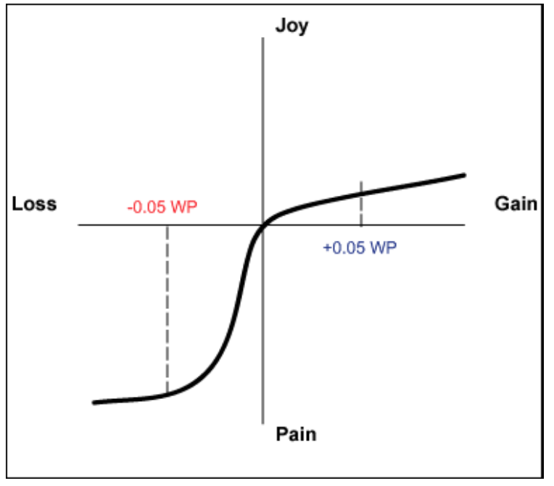
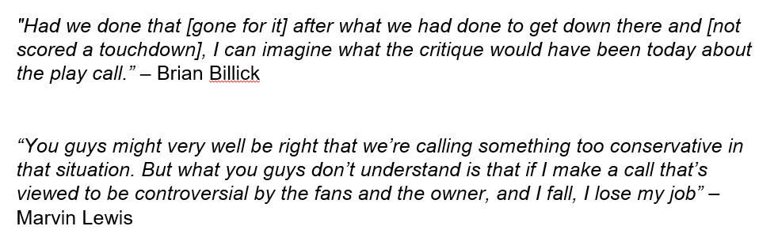
Fourth-Down Decisionmaking
Why would coaches act this way?
Loss Aversion
Risk Aversion/Minimax
Source: https://github.com/statsbylopez/StatsSports20/blob/master/Lectures/lecture%206.pdf

Slide 35
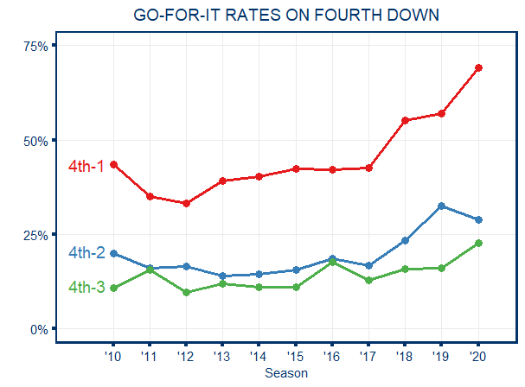
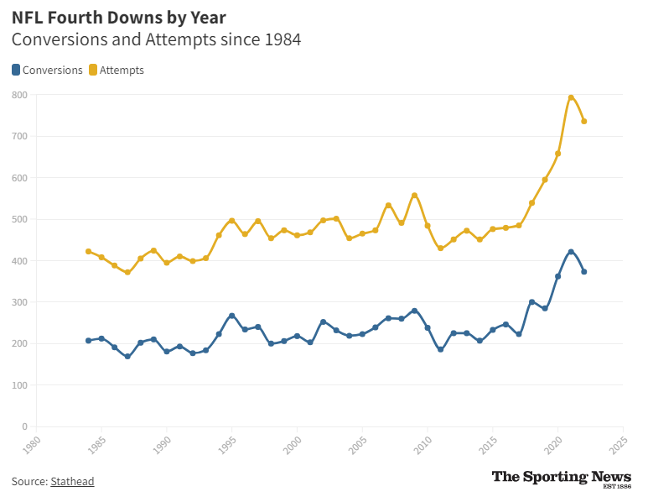
Fourth-Down Decisionmaking
We’re making inroads!
Of course, not perfect. Matt Lafleur (GB) vs. Dennis Allen (NO)
Follow 4th down decision bot Twitter account (when it can tweet…), @sethwalder for more
Source: https://github.com/statsbylopez/StatsSports20/blob/master/Lectures/lecture%206.pdf; https://www.sportingnews.com/us/nfl/news/nfl-fourth-down-conversion-chart-rate-by-distance/vofkeub6xwms6imajxqkfipp

Slide 36
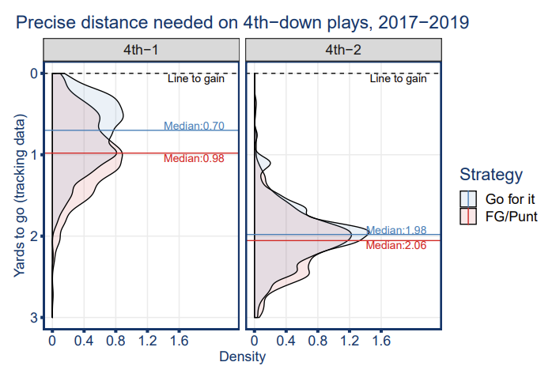
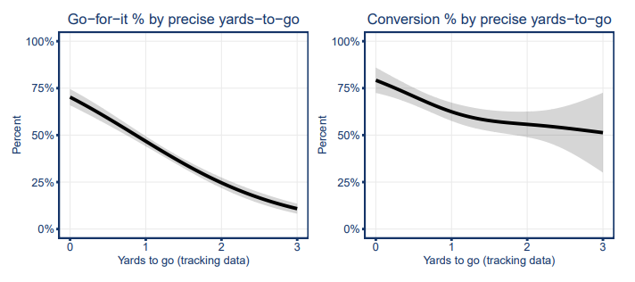
Fourth Down Decisionmaking
Did coaches know more about what they were doing than we gave them credit for?
Once we got better data (ball tracking chip), some very interesting data emerged that changed what we thought we knew
Importance of humility and open-mindedness in analytics
Source: https://arxiv.org/pdf/1909.10631.pdf; https://twitter.com/statsbylopez/status/1176881065941721088?lang=en

Slide 37
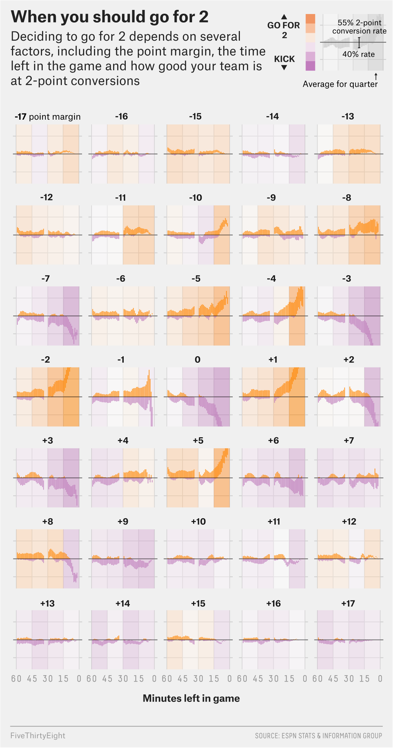
Two-Point Conversions
Extremely similar situation
Go for 2 when down 8
24 times since 2018. Gaining steam.
Go for 2 when down…7!?
Source: https://fivethirtyeight.com/features/when-to-go-for-2-for-real/

Slide 38
Caution on 4th Down Analytics Projects
It’s been done to death publicly
Not an “interesting” project to teams, fellow analysts (become a bit of a joke)
Unless you have new data or a completely different approach, leave it be
(Same thing for 2-pt conversions)

Slide 39
Draft Analytics

Slide 40
Draft Analytics
Say you’re a GM on Draft Day thinking about trading picks with another team
How do you decide when to make a trade?

Slide 41
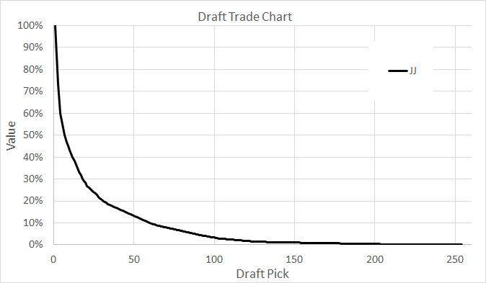
Draft Pick Values
Need to know the value of your picks
Attempt #1: Jimmy Johnson, “The Chart” – from 1990s Cowboys.
Based on actual trades made in 1980s. Problem?
Source: https://www.stampedeblue.com/2019/4/26/18517416/did-chris-ballard-make-a-good-trade-av-value-massey-thaler-draft

Slide 42
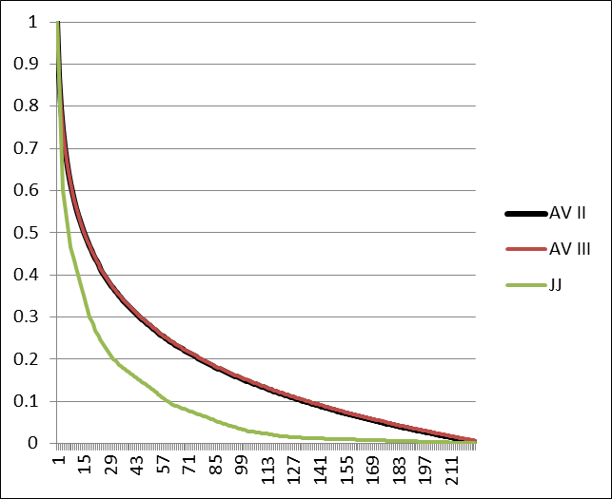
Draft Pick Values
Need to know the value of your picks
Attempt #2: Massey and Thaler; Chase Stuart at Football Perspective
NFL GMs massively overvalued high picks → curve was too steep
Based on first 4 years’ actual Career AV metric from Pro-Football-Reference
Source: http://www.footballperspective.com/yet-another-draft-value-chart/

Slide 43
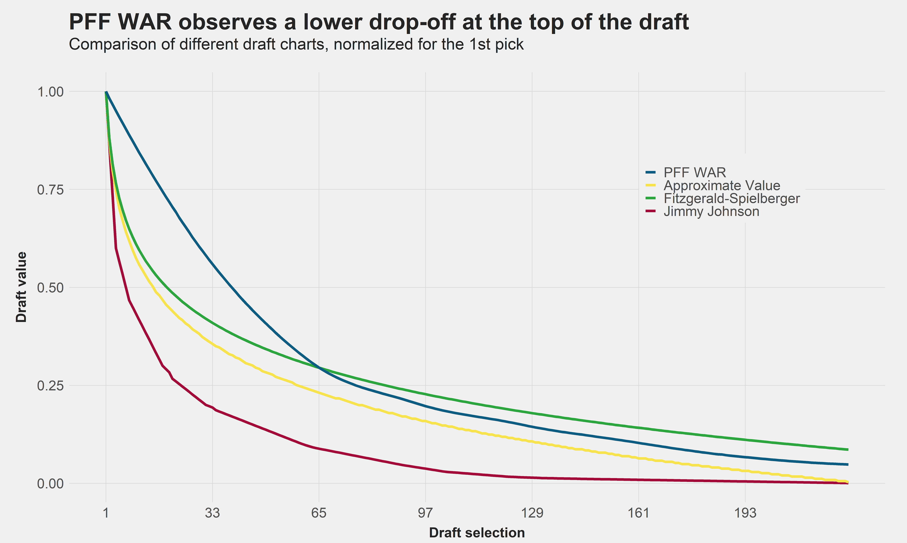
Draft Pick Values
Need to know the value of your picks
Later attempts: Fitzgerald and Spielberger (based off actual post-rookie contract values); Pro Football Focus (based off PFF WAR); many others
All with same conclusion vs. Jimmy Johnson Chart
Source: https://www.pff.com/news/nfl-revisiting-the-losers-curse-the-surplus-value-of-draft-picks

Slide 44
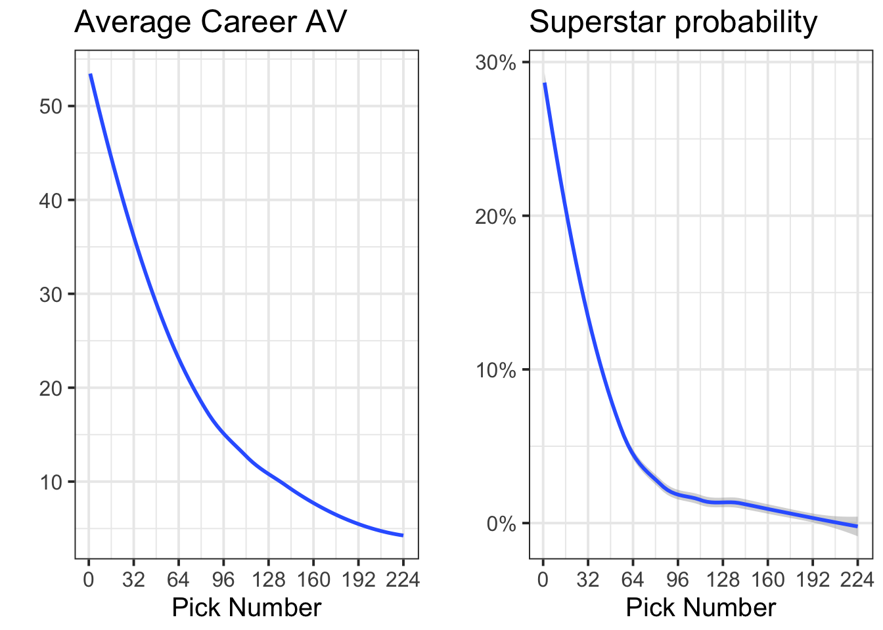
Draft Pick Values
But…is it possible teams are behaving rationally (or more rationally than we give them credit for) even if they over-value top picks?
Instead of making best decisions on “average” player, maybe teams are shooting for a “superstar?”
“High-variance” strategy
“Superstar” = career AV in roughly top 5th percentile
Source: https://statsbylopez.netlify.app/post/rethinking-draft-curve/

Slide 45
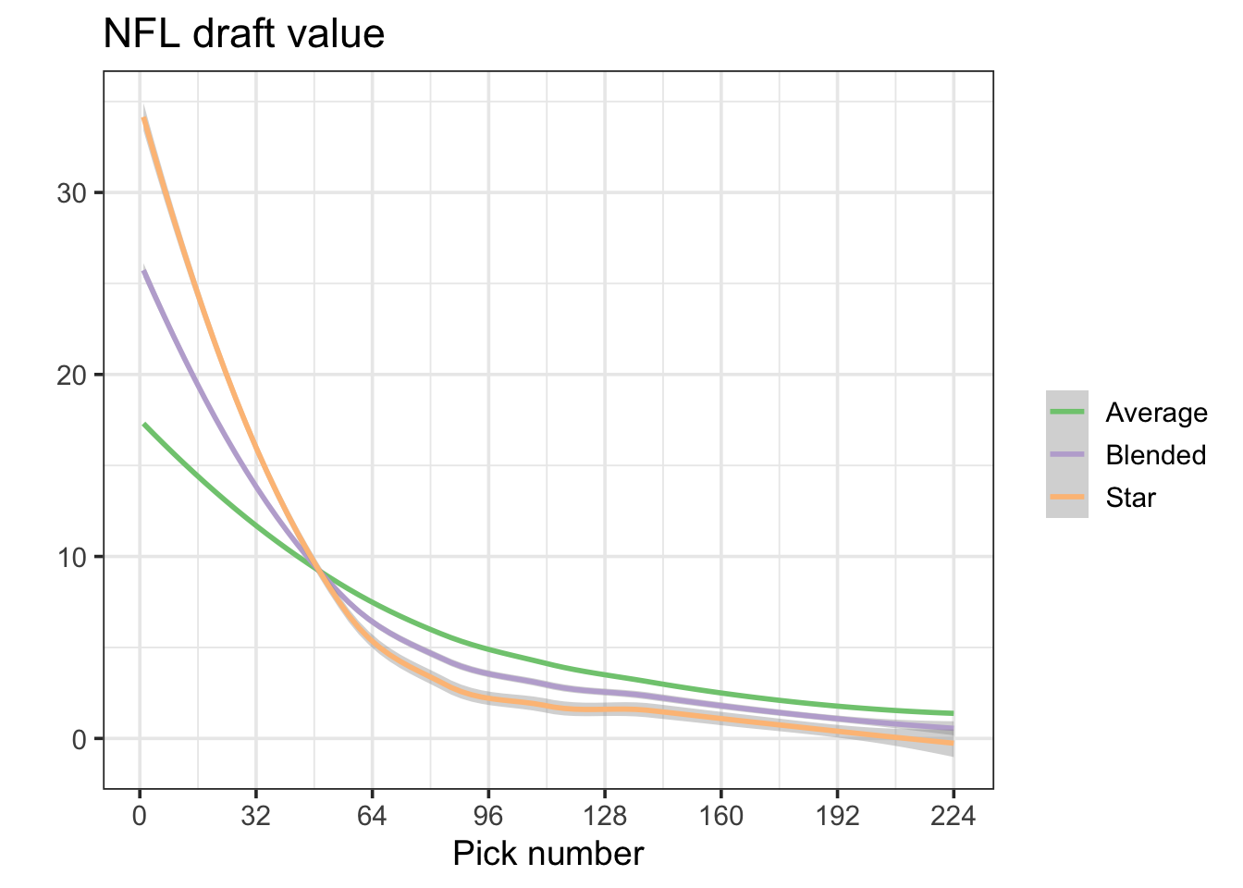
Draft Pick Values
But…is it possible teams are behaving rationally (or more rationally than we give them credit for) even if they over-value top picks?
Source: https://statsbylopez.netlify.app/post/rethinking-draft-curve/

Slide 46
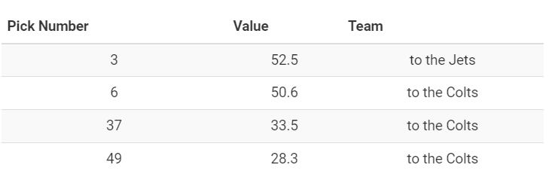
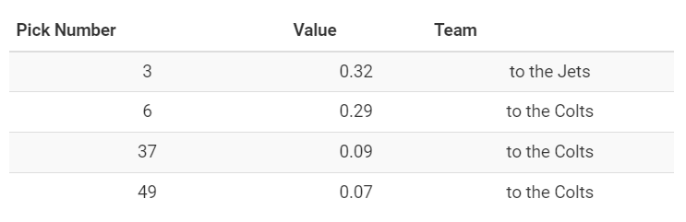
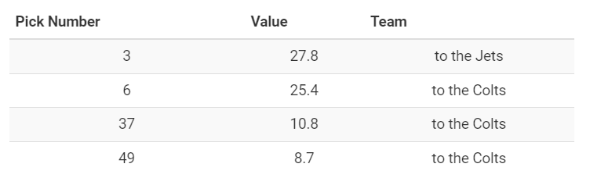
Draft Pick Values
New York Football Jets, 2018 NFL Draft: give Colts #6, 37, 49 (Quenton Nelson, Braden Smith, Dallas Goedert) in exchange for #3 (Sam Darnold)
Avg. Curve
Star Curve
Blended Curve
Source: https://statsbylopez.netlify.app/post/rethinking-draft-curve/

Slide 47
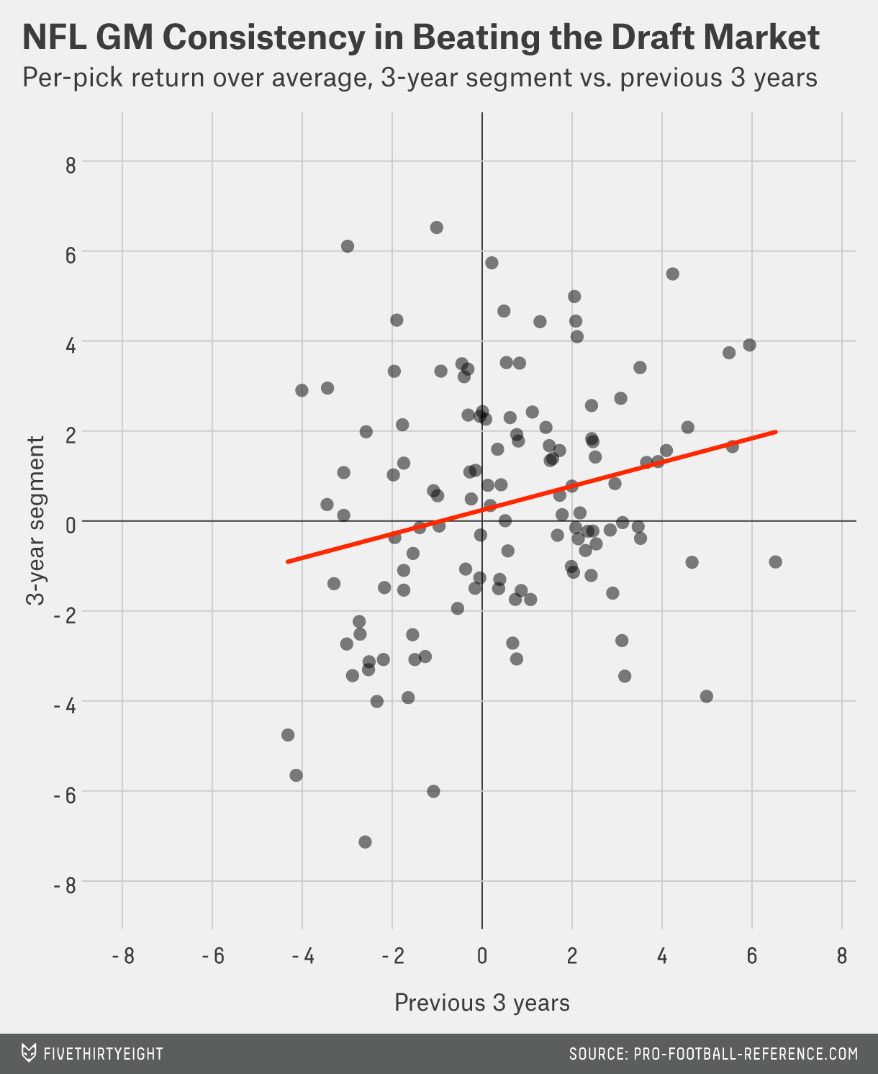
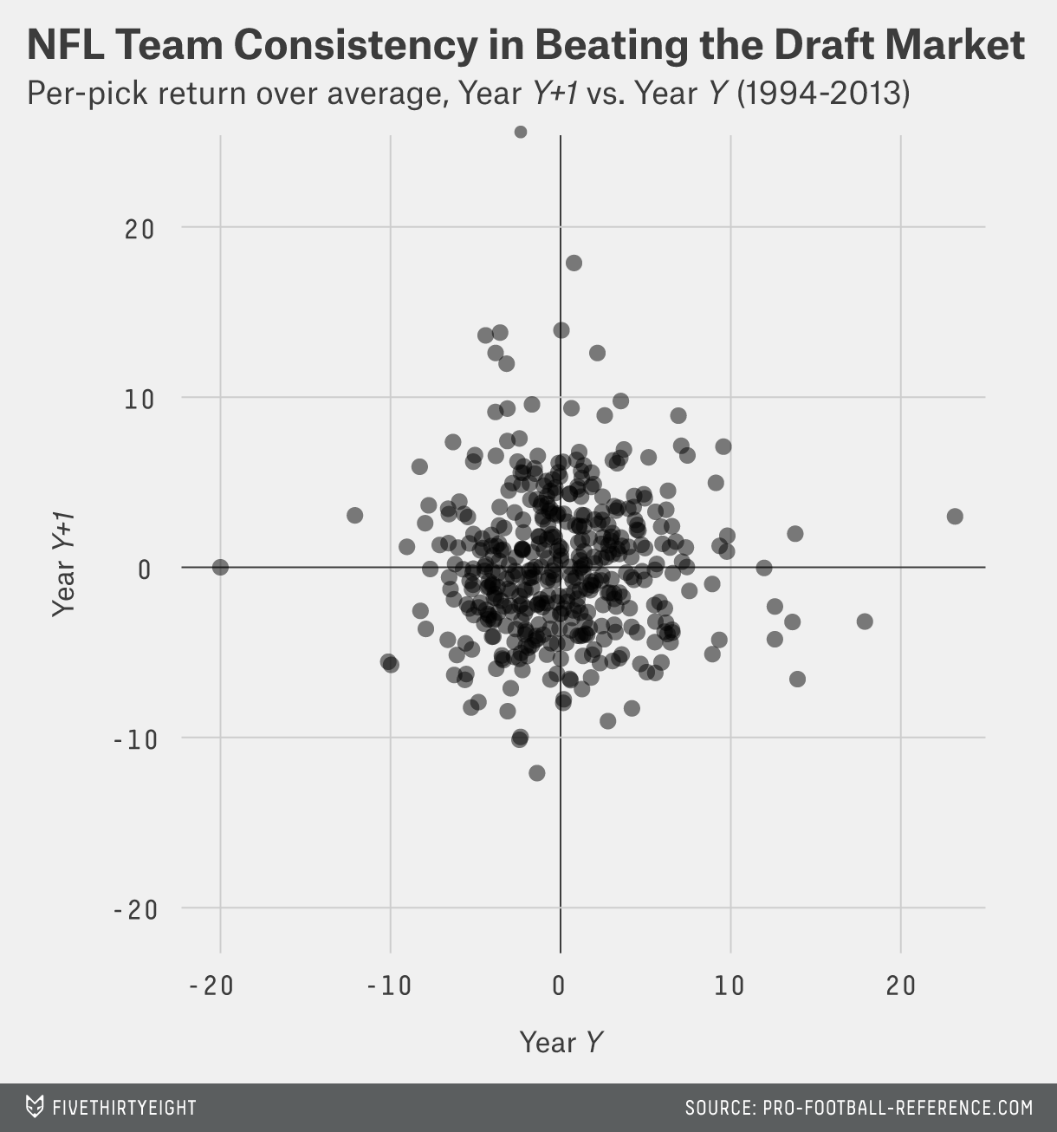
Drafting: Skill or Luck
Are there GMs that are especially good or bad at drafting?
Source: https://fivethirtyeight.com/features/no-team-can-beat-the-draft/

Slide 48
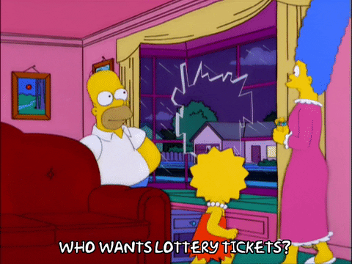
Draft Analytics Conclusions
Analytics current wisdom:
Trading up is dumb
Trade back as much as possible with dumb trade partners
Chances > specific players
Source: https://giphy.com/gifs/season-12-the-simpsons-12x9-l2Je1vl9FHL6MGJxu

Slide 49
NFL Player Valuation Analytics

Slide 50
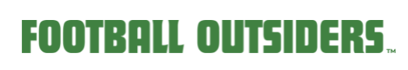
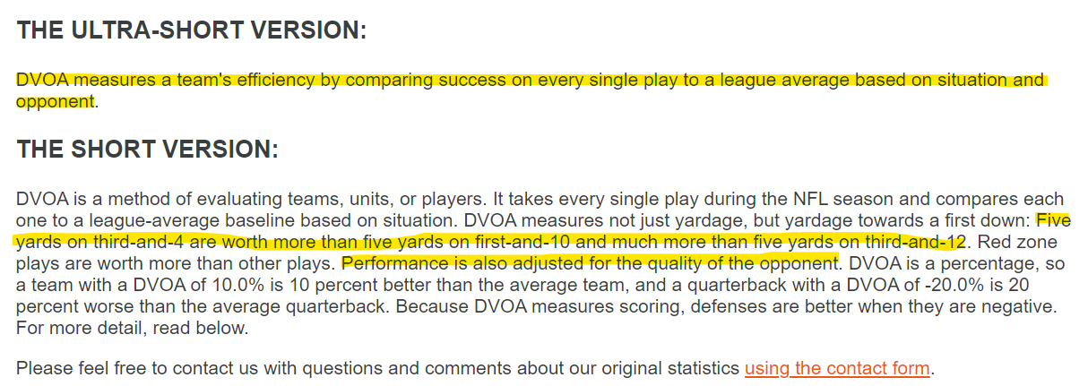

Player Valuation – DVOA
Context. Is. King.
Early modern attempt: Football Outsiders, Aaron Schatz, and Defense-Adjusted Value over Average (DVOA, Teams and Players)
Source: https://www.footballoutsiders.com/info/methods#dvoa; https://www.footballoutsiders.com/stats/nfl/team-efficiency/2021

Slide 51
Player Valuation – QBs and Passing
Context. Is. King.
Let’s focus on the most important position on the field: QBs
Start with “traditional” box score stats (and things we can derive from it, like Completion % and TD/INT ratio)
Dolphins @ Chargers, 9/10/23; Final MIA 36-LAC 34
Source: https://www.espn.com/nfl/game/_/gameId/401547401

Slide 52

Player Valuation – QBs and Passing
Context. Is. King.
Let’s focus on the most important position on the field: QBs
Adjusted Yards per Attempt (AY/A) – Hidden Game of Football (1988)
$\frac{(pass yards + 20∗(pass TD) − 45∗(interceptions thrown))}{Passing Attempts}$
Adjusted Net Yards per Attempt (ANY/A) – Chase Stuart at Football Perspective popularized in 2010s:
$\frac{(pass yards + 20∗(pass TD) − 45∗(interceptions thrown) − sack yards)}{Sacks+Passing Attempts}$
Source: https://www.espn.com/nfl/game/_/gameId/401547401; https://www.pro-football-reference.com/about/glossary.htm#ay/a

Slide 53

Player Valuation – QBs and Passing
Context. Is. King.
Let’s focus on the most important position on the field: QBs
ANY/A leaders, 2022
Source: http://www.footballperspective.com/2019-rearview-adjusted-net-yards-per-attempt/; https://www.pro-football-reference.com/years/2022/passing.htm

Slide 54

Player Valuation – QBs and Passing
Context. Is. King.
Let’s focus on the most important position on the field: QBs
RTG = Passer Rating
Range 0-158.3 (???)
Seems great/comprehensive…actually stinks
Source: https://www.espn.com/nfl/game/_/gameId/401547401 ; https://en.wikipedia.org/wiki/Passer_rating

Slide 55
Player Valuation – QBs and Passing
Context. Is. King.
Let’s focus on the most important position on the field: QBs
QBR = (Total) Quarterback Rating
Not bad at all. Accounts for rushes, uses EPA framework, attempts to divide credit, scales to 0-100.
Rough interpretation: chance of QB winning with an average supporting cast
Drawbacks: proprietary (must trust ESPN, can’t interrogate it ourselves); maybe outdated vs. modern methods?
Source: https://www.espn.com/nfl/game/_/gameId/401547401 ; https://www.espn.com/blog/statsinfo/post/_/id/123701/how-is-total-qbr-calculated-we-explain-our-quarterback-rating

Slide 56

Player Valuation – QBs and Passing
Context. Is. King.
Let’s focus on the most important position on the field: QBs
QBR = (Total) Quarterback Rating leaders, 2022
Source: https://www.espn.com/nfl/qbr

Slide 57


Player Valuation – QBs and Passing
Context. Is. King.
Let’s focus on the most important position on the field: QBs
Split passes into two pieces: air yards (a/k/a average depth of target, aDOT) and yards after the catch (YAC)
Source: https://twitter.com/NextGenStats/status/1443773324186685441

Slide 58


Player Valuation – QBs and Passing
Context. Is. King.
When considering air yards vs. YAC: credit split for QBs vs. WR/TEs? Implications for evaluating completion percentage, game play styles?
Source: https://sumersports.com/the-zone/the-ingredients-of-yards-after-catch-in-the-nfl/ ; https://arxiv.org/abs/1802.00998

Slide 59


Player Valuation – QBs and Passing
Context. Is. King.
Let’s focus on the most important position on the field: QBs
(Direct) EPA and WPA frameworks
Source: https://rbsdm.com/stats/stats/

Slide 60
WAR (Huh! What Is It Good For?)
What’s the goal in football (or any sport?)
So if you could wave a magic wand and get one holistic stat about any player, what would it be?

Slide 61
WAR (Huh! What Is It Good For?)
How many wins does a player contribute?
Then just go out and get the player who contributes the most wins at every position, right?

Slide 62
WAR (Huh! What Is It Good For?)
Salary cap (hard or soft) – makes owners and general managers think about player value
How much is this athlete worth over and above some baseline?
Wins Above Replacement (WAR):
Ultimate player value metric
How much $ is a win worth x (total) WAR = contract value

Slide 63


Baseline: Replacement Level
Replacement Level:
Source: https://library.fangraphs.com/misc/war/replacement-level/; https://www.baseball-reference.com/about/war_explained.shtml

Slide 64
Player Valuation – QBs and Passing
Context. Is. King.
Let’s focus on the most important position on the field: QBs
Translate EPA and WPA to WAR
Source: https://arxiv.org/abs/1802.00998

Slide 65
Player Valuation – Other Positions
Context. Is. King.
Can apply many of these same ideas to other (offensive skill) positions
Volume vs. Rate stats (Rushing yards vs. YPC)
EPA, WPA, and WAR for all players
Wide Receivers (WRs) and Tight Ends (TEs): YAC vs. aDOT
Running Backs (RBs): yards before contact vs. yards after first contact, etc.

Slide 66
Tracking/Next Gen Stats (NGS) Data
Applications (play and player valuation)
Big data bowl

Slide 67


What is NFL Tracking Data?
Also called Next Gen Stats (NGS)
Chips in shoulder pads and ball
Record and transmit position (and by extension speed, distance, accel) every 0.1s
Source: https://operations.nfl.com/gameday/technology/nfl-next-gen-stats/; https://statsbylopez.netlify.app/post/r-for-nfl-analysis/

Slide 68

What is NFL Tracking Data?
Chips in shoulder pads and ball
Record and transmit position (and by extension speed, distance, accel) every 0.1s
Source: Yurko et al https://docs.google.com/presentation/d/1j1CzZncIFBtP0qjnStcD505JSxvv3q5XejP0QtWsE_o/edit#slide=id.g603f6a946c_0_67

Slide 69



Uses of Tracking Data
Even more advanced play valuation (passes):
Expected completion percent for any pass
Source: https://www.nfl.com/news/next-gen-stats-introduction-to-completion-probability-0ap3000000964655; https://twitter.com/NextGenStats/status/1443766941580103690?s=20

Slide 70

Uses of Tracking Data
Even more advanced play valuation (runs):
Source: Yurko et al https://docs.google.com/presentation/d/1j1CzZncIFBtP0qjnStcD505JSxvv3q5XejP0QtWsE_o/edit#slide=id.g603f6a946c_0_51

Slide 71


Uses of Tracking Data
Even more advanced play valuation (runs):
Expected rushing yards vs. actual rushing yards
Source: Yurko et al https://docs.google.com/presentation/d/1j1CzZncIFBtP0qjnStcD505JSxvv3q5XejP0QtWsE_o/edit#slide=id.g603f6a946c_0_51

Slide 72

Uses of Tracking Data
Even more advanced play valuation (runs):
Expected rushing yards vs. actual rushing yards
“The Zoo” 2019 Big Data Bowl
Deep learning model for runs just letting a neural net sort out predictions based on location, speed, and direction of all 22 players relative to rusher and opposing players. Produces:
Source: https://www.nfl.com/news/next-gen-stats-intro-to-expected-rushing-yards

Slide 73


Uses of Tracking Data
More advanced player valuation:
Context is king. Key improvement: how do players actually perform relative to similar situations (that is, vs. how we would expect them to do)?
Source: https://twitter.com/NextGenStats/status/1443669550805880846?s=20; https://rbsdm.com/stats/stats/

Slide 74


Uses of Tracking Data
More advanced player valuation:
Context is king. Key improvement: how do players actually perform relative to similar situations (that is, vs. how we would expect them to do)?
Source: https://mfbanalytics.shinyapps.io/RYOE/

Slide 75


Uses of Tracking Data
Field ownership/zone of control:
Source: https://statsbylopez.netlify.app/post/r-for-nfl-analysis/

Slide 76


Uses of Tracking Data
New ways to look at player trends, do automated opponent scouting
Source: https://statsbylopez.netlify.app/post/r-for-nfl-analysis/

Slide 77


Uses of Tracking Data
NFL’s own NGS team produces novel public charts and stats for fans and broadcasts (check out NGS Twitter feed and website for more)
Source: https://twitter.com/NextGenStats

Slide 78

Uses of Tracking Data
Big Data Bowl
Since 2018, NFL has released a selection of tracking data for public analysis in a competition
Themes:
2018 – WR Route and Passing Analytics
2019 – Predict Rush Yards
2020 – Pass Defense Analytics
2021 – Punt Analytics
2022 – Pass Rushing Model
2023 – TBA soon!!
Other contests on Kaggle from NFL Health & Safety, too (punt play injury prevention, helmet video tagging for head injuries)
Source: https://operations.nfl.com/gameday/analytics/big-data-bowl/

Slide 79
Uses of Tracking Data
Big Data Bowl
Interested?
2023 contest opening soon on Kaggle
Talk with others, form a team; Oxford Sports Analytics Club?
Check the website: https://operations.nfl.com/gameday/analytics/big-data-bowl/
Follow @statsbylopez and #BigDataBowl on Twitter (and GET TWITTER if you don’t already have an account!)
If you like streamers, follow my man Nick Wan (now Reds analytics, formerly – I’m not kidding – KFC) analyzing the data on Twitch (from 2021; maybe he’ll repeat?)
Source: https://operations.nfl.com/gameday/analytics/big-data-bowl/

Slide 80
Lineman Analytics: Pass Blocking and Rushing
Survival Analysis

Slide 81
Lineman Analytics
Evaluating offensive skill players (QB, RB, WR, TE) fairly advanced
“See” their contributions easily in a throw, run, or catch
Offensive line (OL) and defense lag behind due to few or unstable (INTs, Sacks) individual traditional stats
(Public) charting of defense, in particular, has become more accessible in recent years (pass break-ups, QB pressures, etc.) – but still missing contributions on plays where player doesn’t “do” something distinct

Slide 82
OL Pass Blocking Analytics
How can you evaluate an offensive or defensive lineman?
What are their jobs on this play?
Source: https://twitter.com/benbbaldwin/status/1442928810010169347; https://www.espn.com/nfl/playbyplay/_/gameId/401326376

Slide 83
Linemen Pass Blocking Analytics
We already know we can use statistics to predict:
1. The value of something (linear regression)
2. The probability of something (logistic regression)
But we can also predict:
3. The time it takes for something to happen (survival analysis)
Source:

Slide 84

Linemen Pass Blocking Analytics
Survival analysis: model the “time-to-event”
Pass blocking/rushing: time to “beaten” block
Requires tracking data
Is longer or shorter better here for a.) OLs and b.) DLs?
Source: https://www.espn.com/nfl/story/_/id/24892208/creating-better-nfl-pass-blocking-pass-rushing-stats-analytics-explainer-faq-how-work

Slide 85

Linemen Pass Blocking Analytics
Survival analysis: model the “time-to-event”
ESPN also calculates individual pass rush win rate (PRWR) and pass block win rate (PBWR) for DLs and OLs, respectively
% of passing plays in which you beat/sustain block for 2.5s
Current leaders
Source: https://www.espn.com/nfl/story/_/id/29939464/2020-nfl-pass-rushing-run-stopping-blocking-leaderboard-win-rate-rankings

Slide 86

Thanks!
Questions? zbinney@emory.edu, @binney_z on Twitter

